Slide 1
A Survey On Stress In Modern Era

Slide 2
Presented By :
BSDSF21A010 Eman Zahid
BSDSF21A022 Zoha Emaan
BSDSF21A026 Zobia Bilal
BSDSF21A040 Barira Sajjad

Slide 3
Motivation
SENSE OF STRESS AND ANXIETY AROUND US.
INCREASING BURDEN ON ONE’S SHOULDERS.
•FINANCIAL STRESSES
•HEALTH STRESSES
•FAMILY STRESSES
…..many more
FIND THE ROOT CAUSE OF STRESS AND PUT AN EFFORT TO RESOLVE IT OUT.

Slide 4
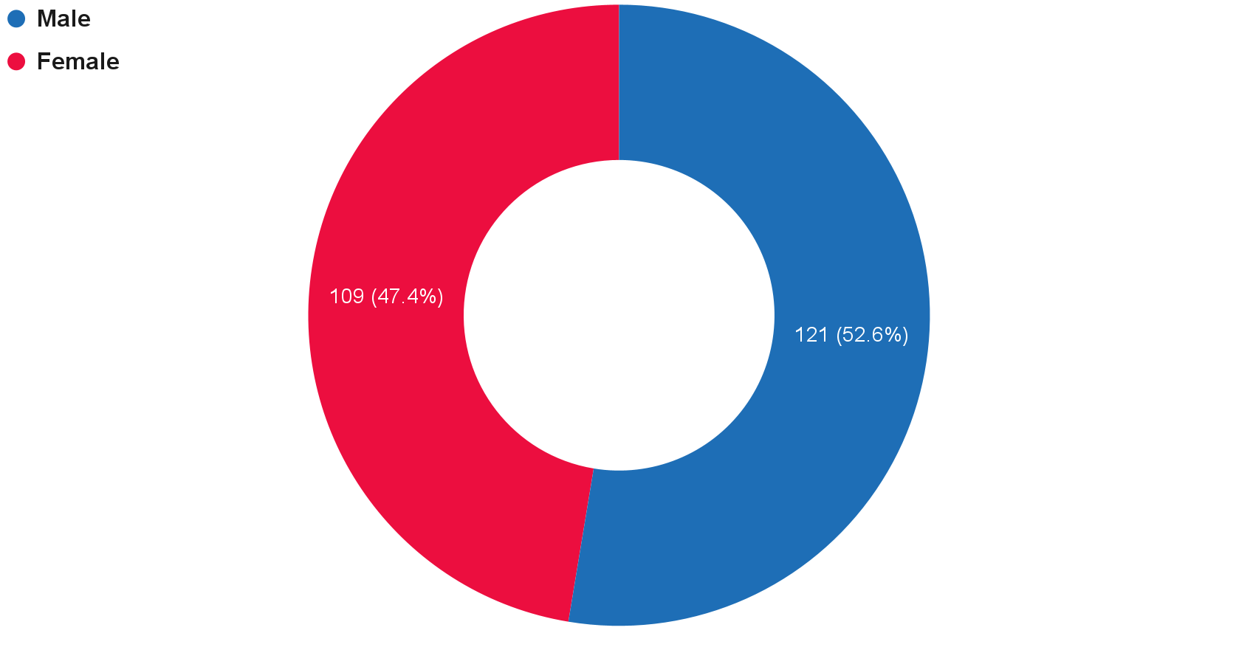
Gender:

Slide 5
We have used proportion to find out the number of female and male respondents. 0.53 respondents identify as male whereas 0.47 identify as female.(p^=x/n)

Slide 6
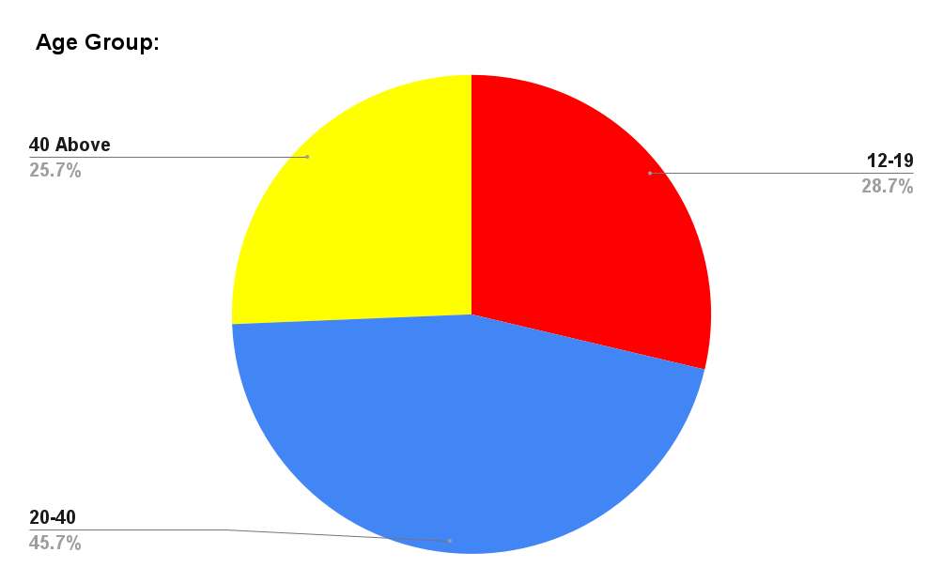
Age Group:
(59)
(66)
(105)

Slide 7
To calculate the mean age of the respondents who took this survey we have used mean formula and have found that the mean age of the respondents is somewhere between 30-31 years.(Mean = ∑fx/f )

Slide 8
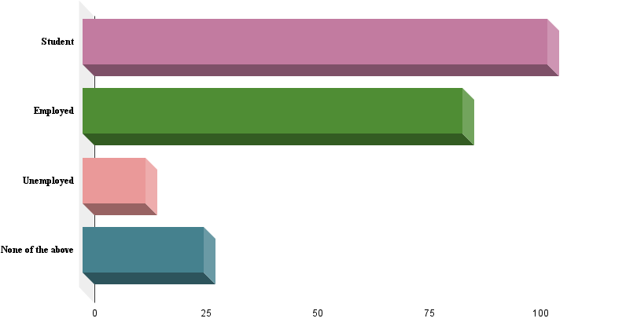
Occupation:
Student
45.2%
(104)
Employed
37%
(85)
Unemployed
6.1%
(14)
None of Above
11.7%
(27)

Slide 9
Confidence Interval:
The confidence intervals for the proportions are listed below:
Confidence interval for employed
0.308 < p < 0.432
Confidence interval for unemployed
0.030 < p < 0.090
Confidence interval for student
0.386 < p < 0.514
All confidence intervals are calculated with 95% confidence level

Slide 10
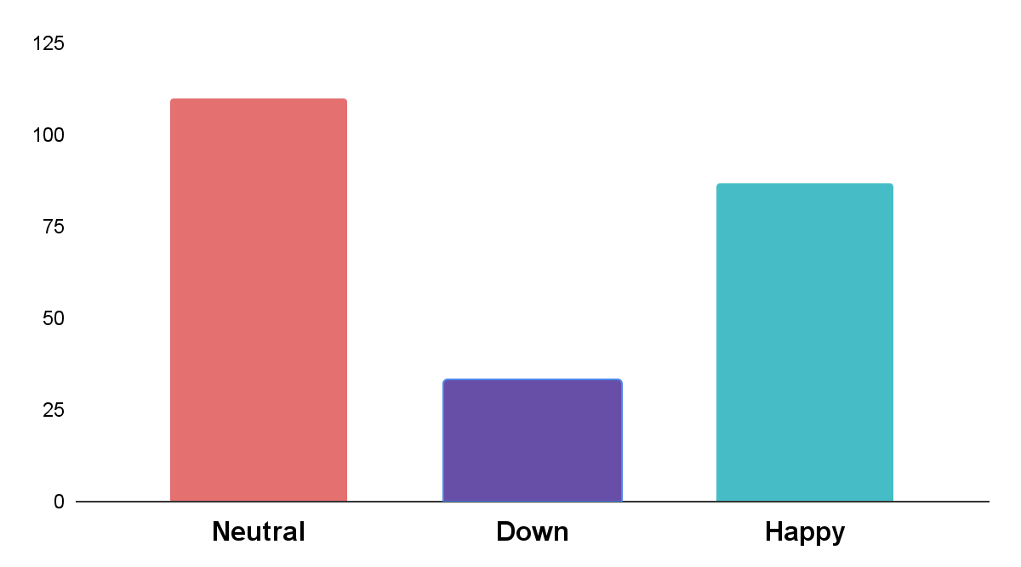
1. How are you feeling today?
47.8%(110)
37.8%
(87)
14.3%(33)

Slide 11
Hypothesis
50% of the population feels happy.
H0: p = 0.50
H1: p ≠ 0.50
⍺ = 0.025
|Zcal| > Ztab
|-3.943| > 1.96 (True)
As statement is true so H0 will be rejected.

Slide 12
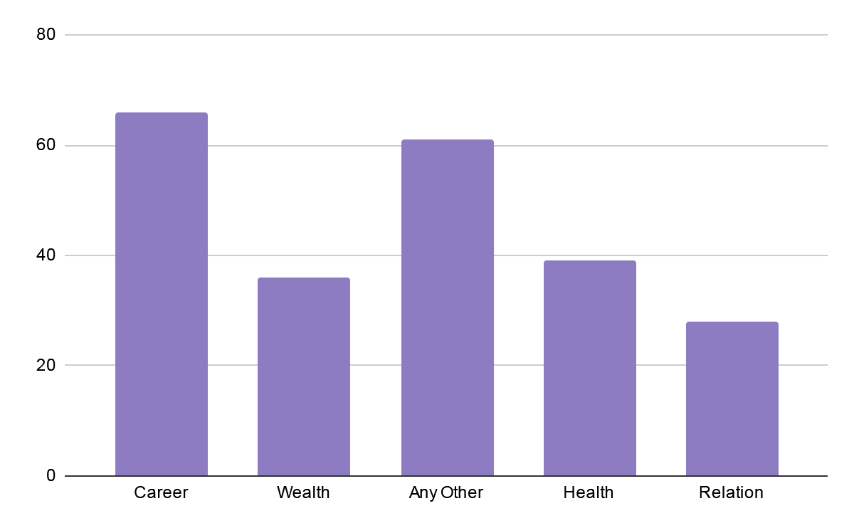
2.What is the major stress that you are facing?

Slide 13
Confidence Interval
Risk 1
By taking the confidence interval of the maximum and minimum class we get these results.
For career class the confidence interval is 0.22 < p < 0.33 with 95% of accuracy.
For the class Relation the confidence interval is: 0.10< p <0.14 with 95% of accuracy.

Slide 14
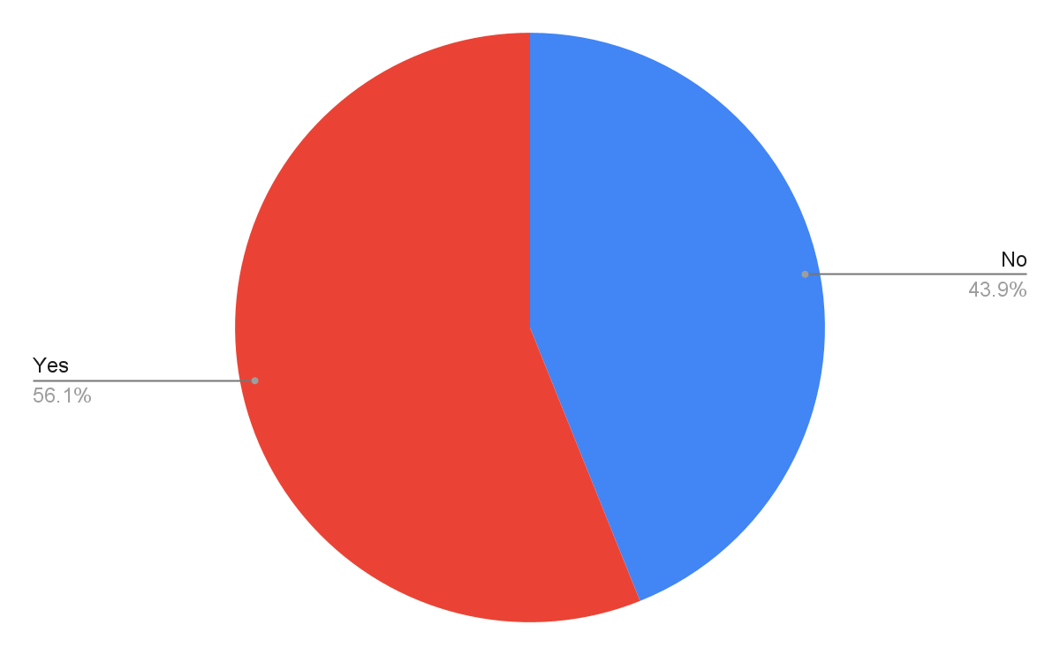
3. Do you have enough time for yourself?
Point estimation of Proportion in the survey concludes that 0.56 people think that Yes they have enough time for themselves, while 0.43 don’t have.(p^=x/n)
Ris Ri

Slide 15
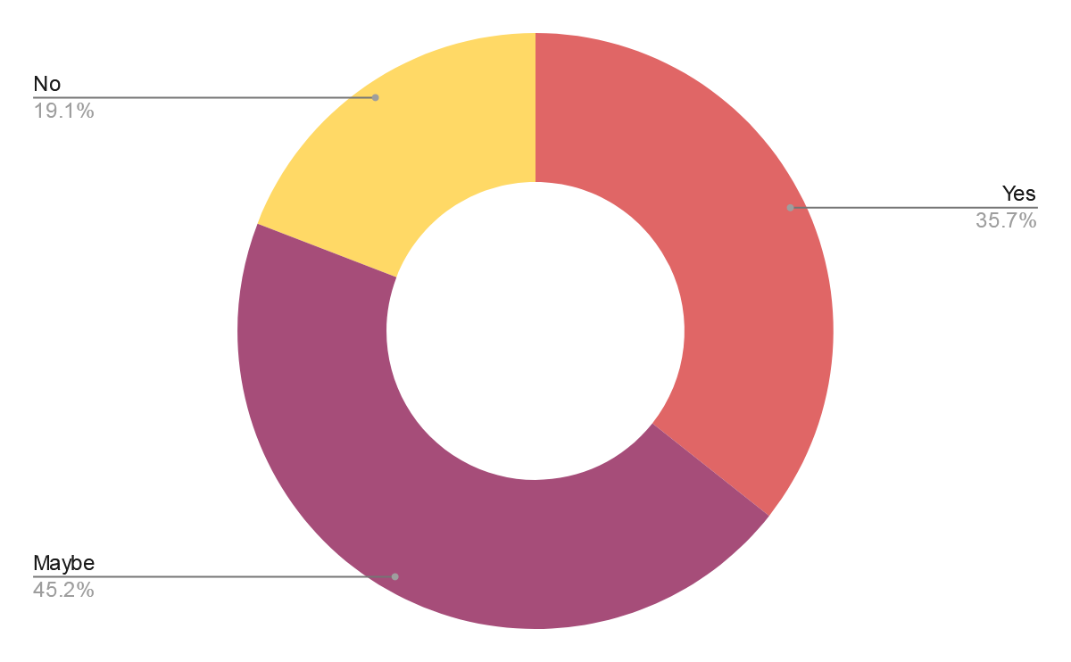
4. Do you feel you are doing things because you have to?
hfhfjf

Slide 16
Hypothesis
70% of the population thinks they are doing work by force.
H0: p=0.70
H1: p<0.70
Alpha = 0.05
Z cal < -Z tab
-1.22 < -1.645
So we will accept Ho.

Slide 17
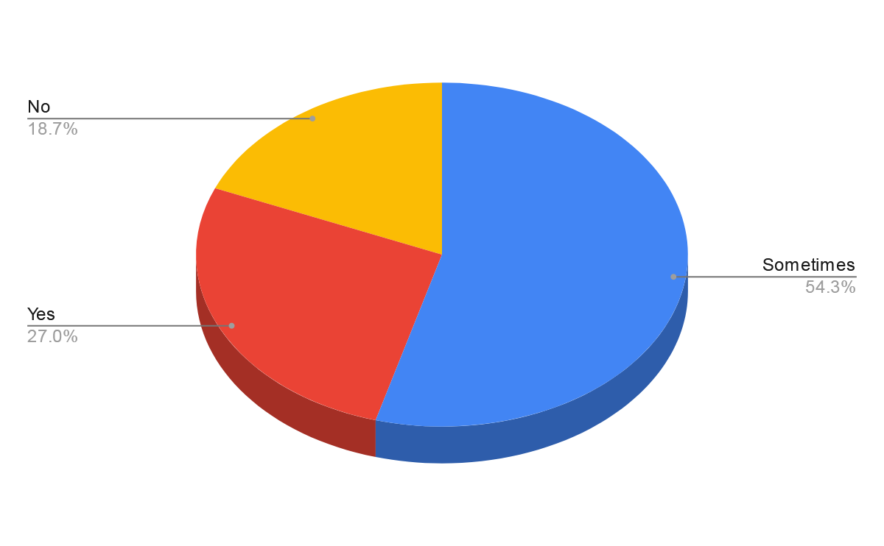
5. Do you panic because of burden?
Assignment 1

Slide 18
The point estimate of proportion of people who think that sometimes they feel panic because of workload and burden is 0.541, while the proportion of people who think opposite of this is 0.459. (p^=x/n)

Slide 19
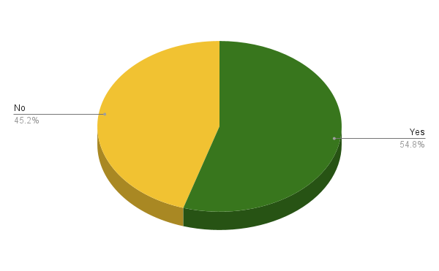
6.Do you fear you may not attain your goals ?

Slide 20
HYPOTHESIS
50% of the population fear that they might not attain their goals .
H0: p = 0.50
H1: p > 0.50
Alpha = 0.05
Z cal > Z tab
1.213 > 1.645 (False)
As, statement is false we will accept H0.

Slide 21
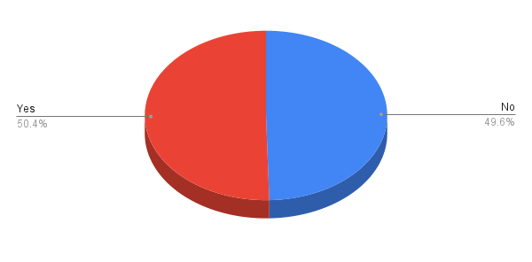
7.Do you think technology is a factor behind stress ?
Proportion is applied in to this data:
The survey concludes that 0.50 people think that Yes technology is a factor behind stress, while 0.49 don’t think .(p^=x/n)

Slide 22
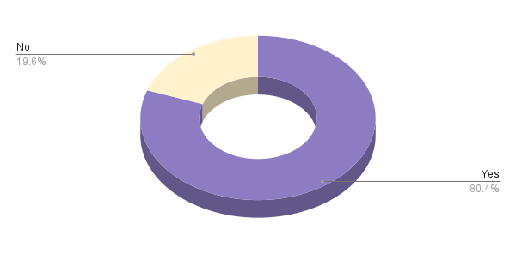
8 . Does the economic condition of our country also contribute to this factor?

Slide 23
HYPOTHESIS
80% of the population thinks that technology is a factor behind stress.
H0: p=0.80
H1: p > 0.80
Alpha = 0.05
Z cal > Z tab
-0.758 > 1.645 (False)
As, statement is false we will accept H0.

Slide 24
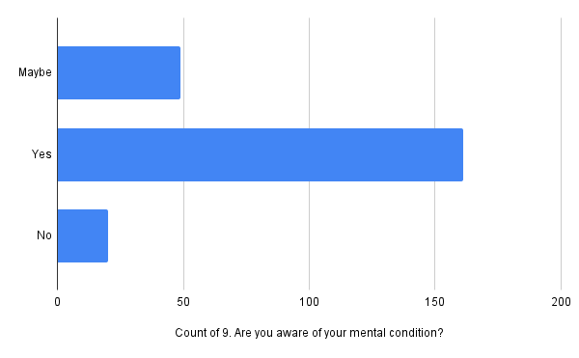
9.Are you aware of your mental condition?

Slide 25
Inference about population
We have calculated confidence intervals for proportions.
Confidence Interval for YES
0.641 < p < 0.759 with 95% accuracy
Confidence Interval for MAYBE
0.16 < p < 0.26 with 95% accuracy
Confidence Interval for NO
0.04668 < p < 0.11332 with 95% accuracy

Slide 26
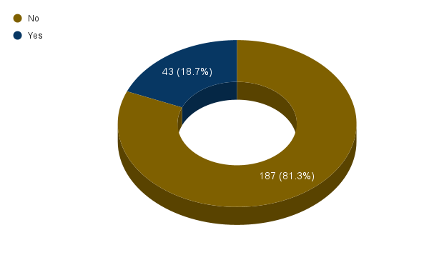
10. Have you encountered any serious suicidal thoughts?
Assignment 1

Slide 27
The point estimate of proportion of people saying they haven’t encountered any suicidal thought is 0.813 and proportion of those who have encountered these thoughts is 0.187. (p^=x/n)

Slide 28
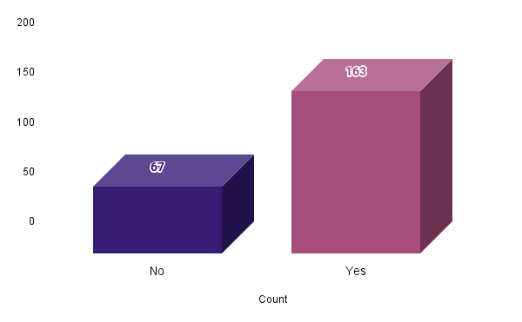
11. Do you think one should consult with a counsellor to relieve stress?

Slide 29
HYPOTHESIS
85% of the population thinks one should consult a counsellor to relieve stress.
H0: p=0.85
H1: p<0.85
Alpha = 0.05
Z cal <- Z tab
-6.37 <- 1.645 (True)
As, statement is true we will reject H0.

Slide 30
Inference about population
Our hopes for getting yes in this question were high. Sadly the survey and the calculations revealed that people who think one should consult with a counsellor are less than 85%.
Confidence Interval
0.641 < p < 0.759 with 95% accuracy

Slide 31
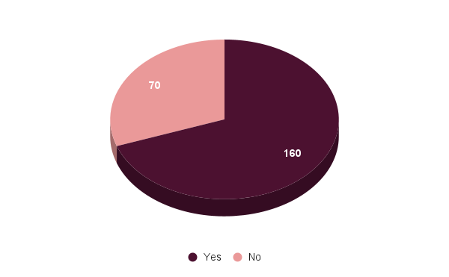
12. Are we becoming judgemental(critic)?

Slide 32
The point estimate of proportion of people who think society as a whole is becoming more and more judgemental is 0.696, while the proportion of people who think opposite of this is 0.304. (p^=x/n)

Slide 33
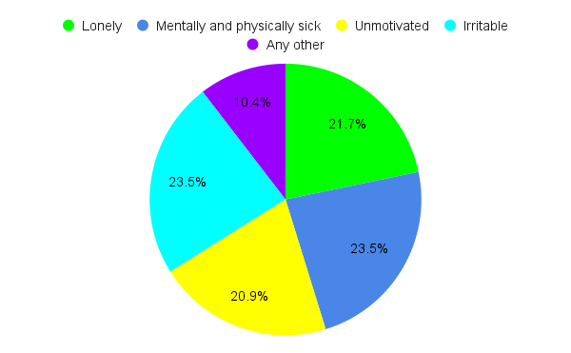
13. How do you feel when you are stressed?

Slide 34
Inference about population
We have calculated confidence intervals for proportions.
Confidence Interval for mentally and physically sick
0.181 < p < 0.289 with 95% accuracy
Confidence Interval for irritable
0.181 < p < 0.289 with 95% accuracy
Confidence Interval for lonely
0.164 < p < 0.27 with 95% accuracy
Confidence Interval for unmotivated
0.157 < p < 0.261 with 95% accuracy

Slide 35
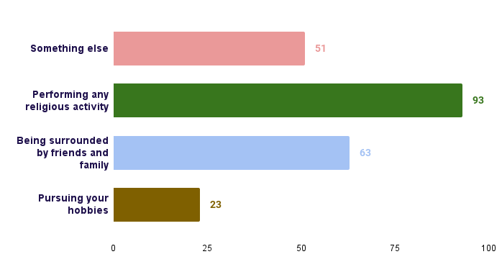
14. What do you do to relieve stress?

Slide 36
Random comments of participants….
Don't lose hope. Keep hanging on until you get back right on track
Be so close to Allah that you start taking difficulties and tensions as a temporary test and never get demotivated by his blessing
Stop comparing yourself with others
Economic is very big problem in our society so many people are jobless jobless is a crime
Everyone should talk to Allah, cry to Allah it gives you the comfort that no one can give
do what you want not what society demands
"you know how lonely and dark it gets when there is no hope ,be hope,spread hope, live hope."
Stay focused on the positive, and avoid negative energy. Rest your mind. Get help from psychologist.
Don’t go to superior university

Slide 37
Conclusions
The major reason of stress is the tension of having a successful career.
Half of the population consider technology as a factor for stress while the other half denies it.
More than 50% of population thinks they will not be able to attain their goals.
The fear of being unsuccessful career or not being able to attain goals suggests that people are mostly scared about their future.

Slide 38
Conclusions
More than ¼ of the population is against the idea of getting treatment from a counsellor(psychiatrist).
People going through stress mostly face mental and physical sickness and become irritable.

Slide 39
Recommendations
Take some break in a day and spend that time with yourself and your friends and family.
Awareness is needed in order to change people views about psychiatrists.
Future is unpredictable but we can cherish the present.
Career counselling should be a must for students.
If a survey happens in future, we will recommend a survey on pressure faced by students or a survey on emerging and extincting fields.

Slide 40
Thank You !

